Slide 1


Automotive Cybersecurity: Risk Assessment
Automotive ECU Penetration Testing with PyCAN
Linda Mafunu

Slide 2

Outline
Introduction
Objectives
Project Scope
Methodologies
Tools and Technology
Best Practices
Challenges
Risk Assessment
Timeline
Conclusion
Questions and Discussion

Slide 3

Introduction
Automobile manufacturers are increasingly focusing their efforts on developing and producing electric vehicles. These developments are based on software contained in Electronic Control Units (ECUs), which act as the primary control centre for all vehicle systems. The Control Area Network (CAN) is a key serial communication protocol that allows for effective, real-time distribution control of ECUs in vehicles. As modern autos rely more on computer systems and communication, safeguarding their security from potential cyber-attacks becomes more critical. To address this issue, this project will focus on building an automated penetration and fuzzing technique on ECUs utilising a PyCAN to find possible security weaknesses, as well as devising and executing corrective steps for any vulnerabilities discovered.

Slide 4
Objectives
The primary objective is to use PyCAN to create a penetration testing framework for automobile ECUs to identify vulnerabilities in communication protocols and potential security flaws.
Research Questions:
RQ1: What are the current vulnerabilities in automobile ECU communication protocols?
RQ2: What are the implications of exploiting these vulnerabilities for automotive system safety and functionality?
RQ3: What mitigation techniques may be used to protect automobile ECUs from these vulnerabilities?

Slide 5
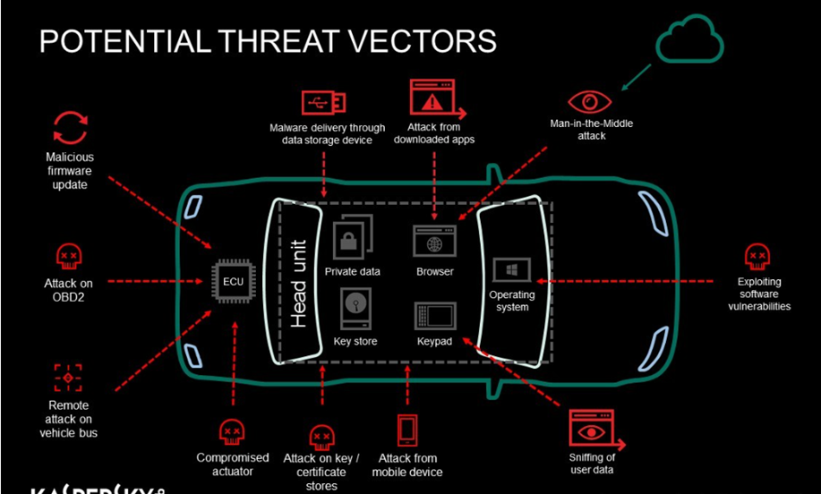
Potential Attacks
Notes:
Picture Reference:
Kirthi. (2023, October 6). Automotive Pen Testing for Beginners. Medium. https://medium.com/@kirthi21105/automotive-pen-testing-for-beginners-0df5f20d684e

Slide 6

Remote Attacks Consequences
Manipulation of Vehicle Control
Data Privacy and Confidentiality Breaches
Integrity Violations
Financial Loss
Notes:
References
Edge Computing Top Cyber Attacks in 2021 & 2022 for the Automotive Industry. (2022, April 30). Edgelabs.ai. https://edgelabs.ai/blog/edge-computing-top-cyber-attacks-in-2021-2022-for-the-automotive-industry/

Slide 7

Case Studies
In September 2016, a team from Tencent's Keen Security Lab hacked Tesla, using CAN vulnerabilities. They successfully executed a remote assault on the Tesla Model S while it was in both Parking and Driving modes, exploiting a complex chain of vulnerabilities. The attack comprised accessing wireless components (Wi-Fi/Cellular) and injecting malicious CAN messages onto the CAN bus (Schellekens, 2016)
The four men stole 53 cars, worth a total of £3.7 million ($4.7 million), using technology that copies and transmits the signal from a key inside an owner's home and their vehicle outside. (Duncan, 2024)
Notes:
References:
Duncan, G. (2024, March 12). Rolls-Royce and Bentleys targeted by gang as luxury cars stolen on industrial scale. The National. https://www.thenationalnews.com/world/uk-news/2024/03/12/rolls-royce-and-bentleys-targeted-by-gang-as-luxury-cars-stolen-on-industrial-scale/
Schellekens, M. (2016). Car hacking: Navigating the regulatory landscape. Computer law & security review, 32(2), 307-315.

Slide 8
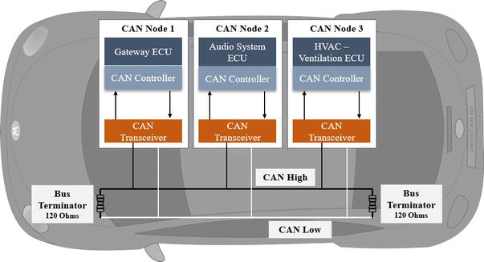
project Scope
The project will focus on a broad range of Electronic Control Units (ECUs) found in modern vehicles
Focus:
Communication Interfaces
Firmware and Software Vulnerabilities
The Types of Attacks to be Simulated:
Unauthorized Access
Data Manipulation
Firmware Tampering
Notes:
Image Reference:
Boland, H. M., Burgett, M. I., Etienne, A. J., & Iii, R. M. S. (2021). An Overview of CAN-BUS Development, Utilization, and Future Potential in Serial Network Messaging for Off-Road Mobile Equipment. In www.intechopen.com. IntechOpen. https://www.intechopen.com/chapters/77277

Slide 9

Methodology
Software Engineering Methodology:
Agile
Penetration Testing
Physical Attacks
Remote Attacks
Use of PY-CAN:
Simulate CAN-bus Messages
Fuzzing Techniques
Project Planning and Reporting

Slide 10
Tools and Technology
Software:
PyCAN Library
Python IDE
Wireshark
Vehicle Diagnostic Tools

Slide 11
Hardware Tools
CAN Interface
Embedded Board
CAN Transceiver
Breadboard and Jumper Wires
Sensors
Notes:
References:
AutoPi.io. (2022b, June 3). Raspberry Pi CAN Bus Integration: An In-Depth Working Guide. AutoPi.io. https://www.autopi.io/blog/raspberry-pi-can-bus-explained/
Peacok, C. (2020, January 17). Adding CAN to the Raspberry PI – Beyondlogic. BeyondLogic. https://www.beyondlogic.org/adding-can-controller-area-network-to-the-raspberry-pi/

Slide 12
Best Practises
Stay Informed
Keep up to date with the emerging laws, regulations
Adapt to changes
Staying updated allows for timely adjustments to security practices
Apply Fuzzing Testing
Effective in finding hackable bugs and code errors that could lead to software crashes

Slide 13
Challenges
Dynamic nature of vehicles can lead to unforeseen vulnerabilities from interaction of defend software components
The lack of standardization in the solutions across different automotive manufacturers and suppliers complicates the process of discovering all components
The cybersecurity threat landscape is constantly evolving, with new types of attacks being developed regularly.

Slide 14
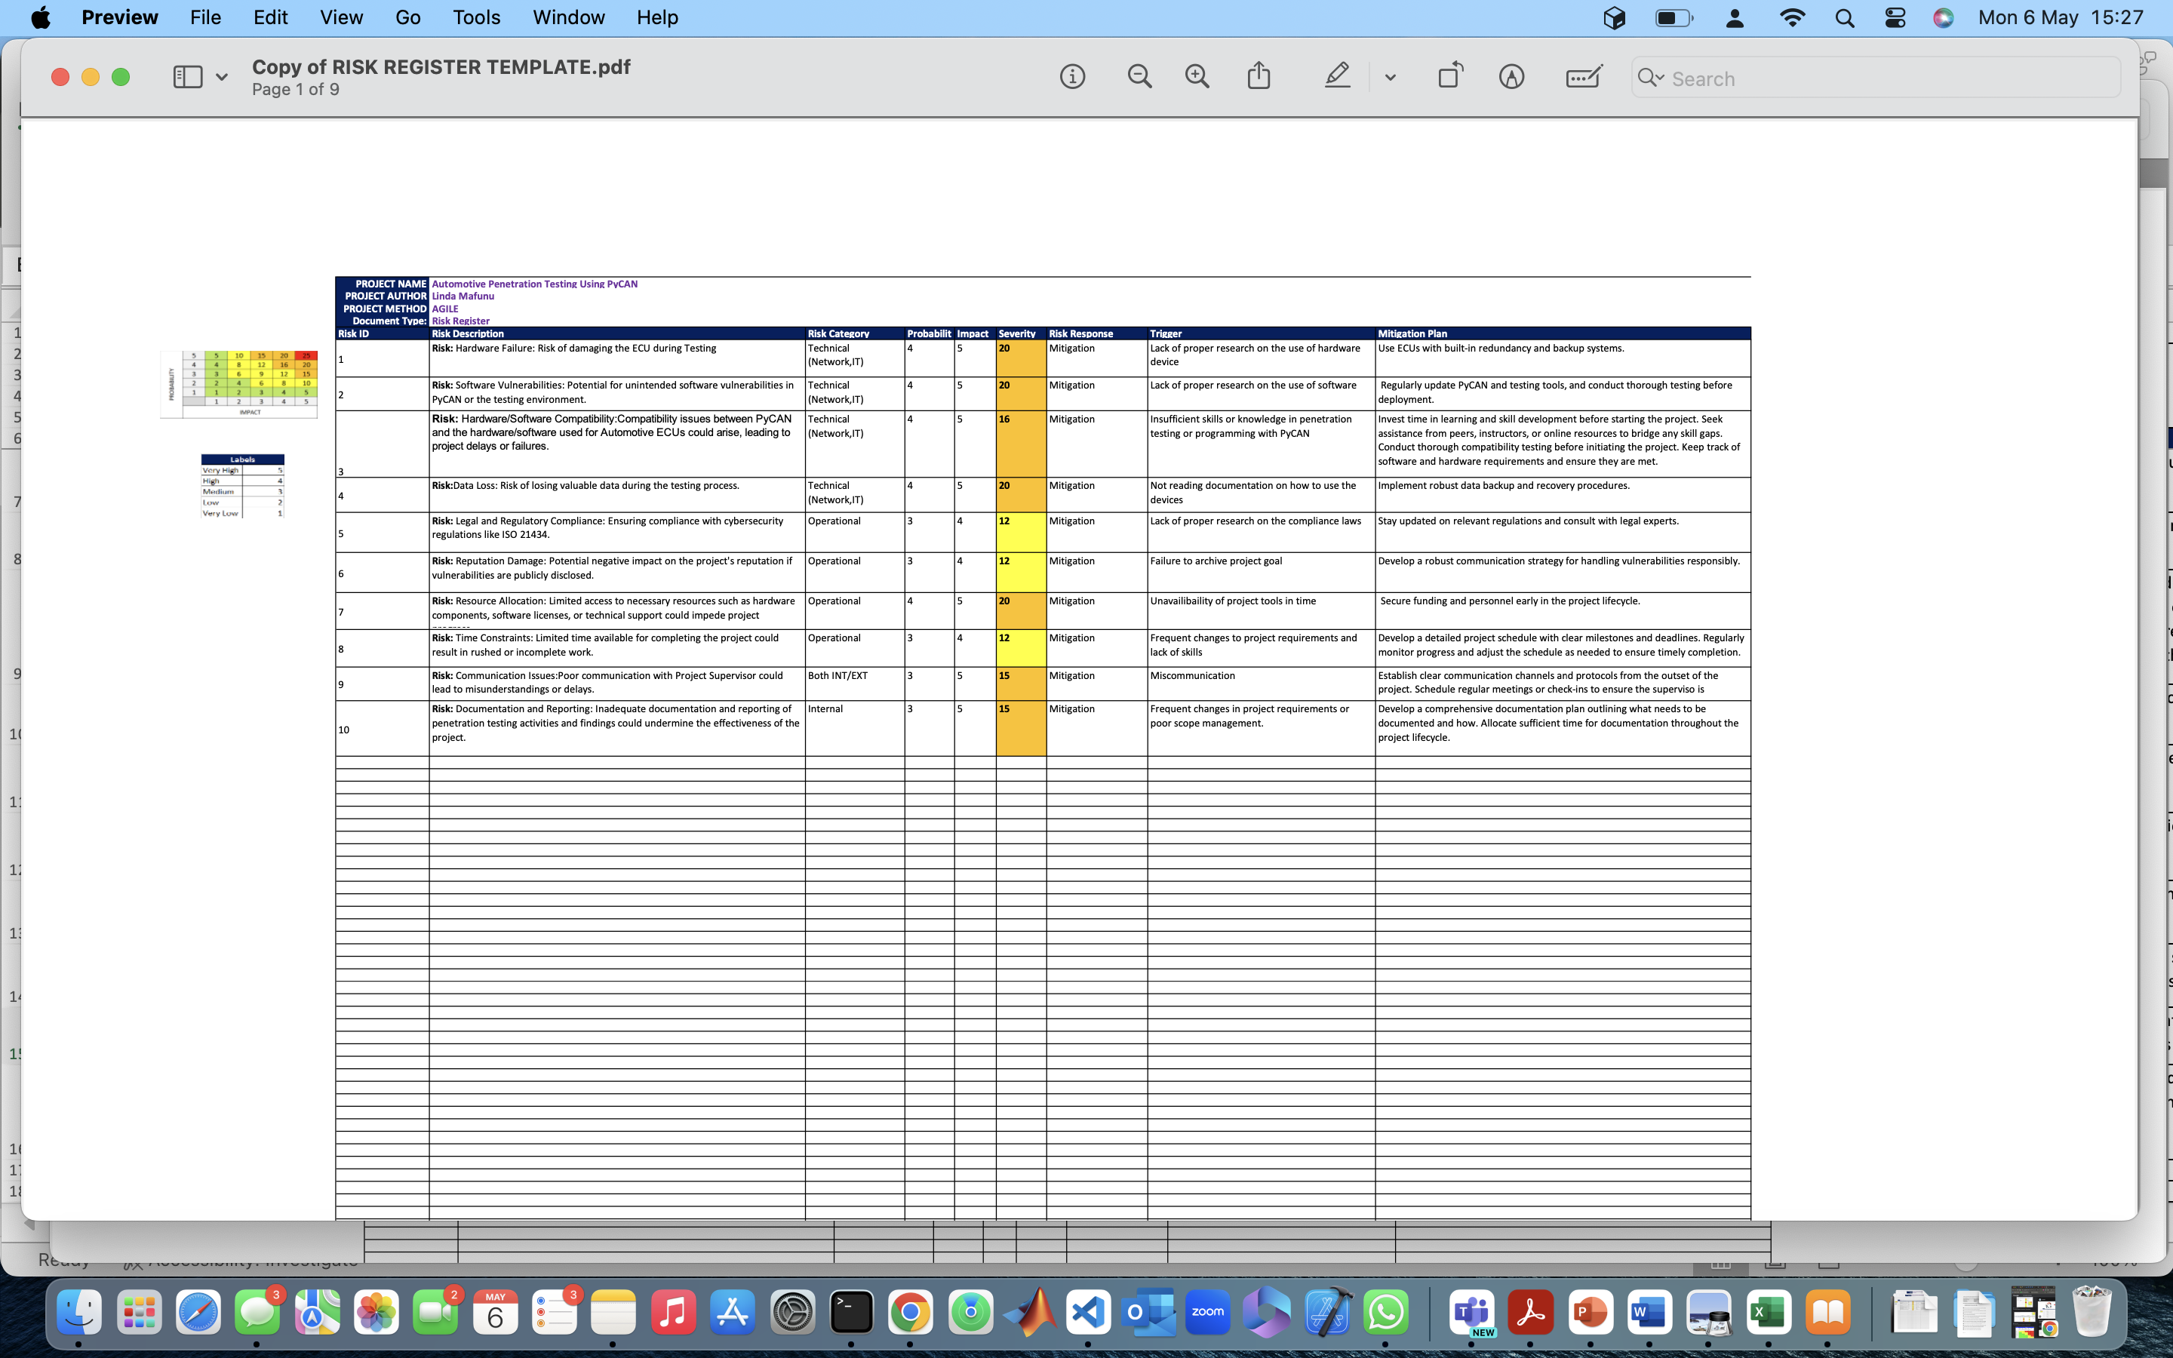
Risk ASSESSMENT
Notes:
Reference for template:
Risk Management, Risk Analysis, Risk Register Template. (n.d.). Www.linkedin.com. https://www.linkedin.com/pulse/risk-management-analysis-register-template-sunil-kumar-dash-itil-4-/
‌

Slide 15
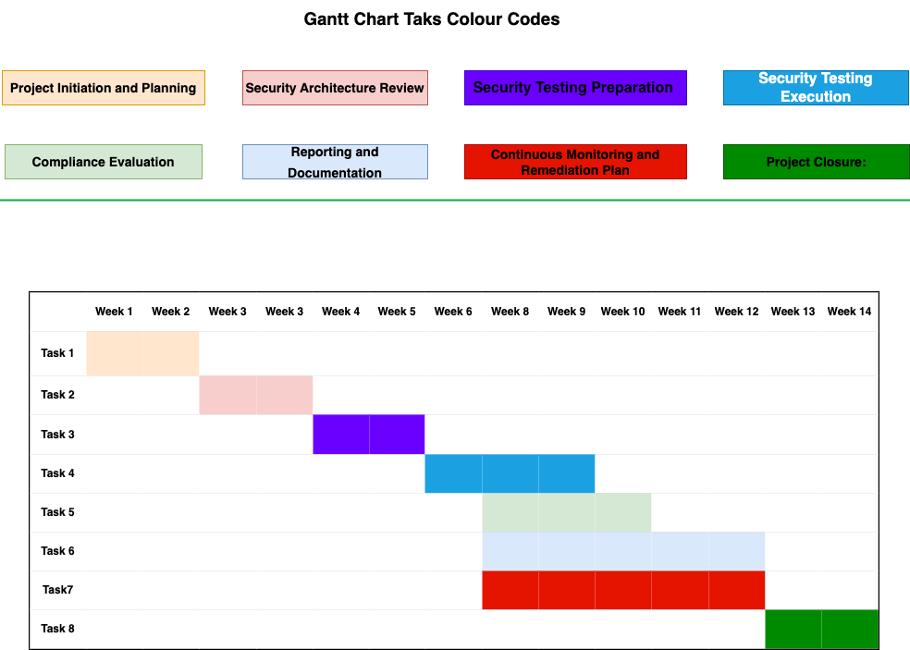
TimeLine
Project milestones:
Project Initiation and Planning: 2 weeks
Security Architecture Review: 2 weeks
Security Testing Preparation: 2 weeks
Security Testing Execution: 3 weeks
Compliance Evaluation: 3 weeks
Reporting and Documentation: 5 weeks
Continuous Monitoring and Remediation Plan: 5 weeks . Go back to 4.
Project Closure: 2 weeks

Slide 16

Conclusion
There is an urgent need for more effective mitigation measures to protect car electronic components and communication networks for driver safety and the financial viability of automotive companies. The project intends to employ previous research methodologies as a reference to conduct penetration testing on automobile ECUs using PyCan to analyse ECU communication protocols for potential security concerns and execute remediation operations for detected vulnerabilities.

Slide 17

Questions and Discussion

